Slide 1
Data Analytics – Lesson 19 Mapping & Population Analysis
Dr. Jeffrey Strickland

Slide 2
Problem Description

Slide 3
Package Descriptions
ggmap: extends the plotting package ggplot2 for maps
rgdal: R’s interface to the popular C/C++ spatial data processing library gdal
rgeos: R’s interface to the powerful vector processing library geos
maptools: provides various mapping functions
dplyr and tidyr: fast and concise data manipulation packages
tmap: a new packages for rapidly creating beautiful maps
install.packages(x)
install.packages(c(“rgdal”, “maptools”, “dplyr”, “tidyr”, “tmap”, “tmaptools”, “rgeos”))

Slide 4
Create a New Project
Starts a new project entitled “Creating-maps-in-R” project using File -> New Project… on the top menu
Start a new R Script using File -> New File… -> R Script
Type all your commands in the R Script
Load the libraries:
library(maptools)
library(dplyr)
library(tidyr) library(tmap) library(rgdal)
library(rgeos)

Slide 5
Load the London Sport Data Using readOGR
The first file we are going to load into R Studio is the “london_sport” shapefile located in the “data” folder of the project.
The readOGR function is used to load a shapefile and assign it to a new spatial object called “lnd”; short for London.
readOGR is a function which accepts two arguments:
dsn which stands for “data source name” and specifies the directory in which the file is stored
layer which specifies the file name (there is no need to include the file extention .shp)
The lnd object contains the population of London Boroughs in 2001 and the percentage of the population participating in sporting activities.
library(rgdal) mydir <-"C:/Users/jeff/Documents/Crime Analysis/Creating-maps-in-R-master/data" lnd <- readOGR(dsn = mydir, layer = "london_sport")
lnd_b <- readOGR(dsn = mydir, layer = "LondonBoroughs")

Slide 6
Explore the Output
Look at the output created (note the table format of the data and the column names).
There are two important symbols at work in the above block of code:
The @ symbol in the first line of code is used to refer to the data slot of the lnd object.
The $ symbol refers to a column (a variable within the table) in the data slot
The head function in the first line of the code above simply means “show the first few lines of data”
The second line calculates finds the mean sports participation per 100 people for zones in London.
head(lnd@data, n = 2)
## ons_label name Partic_Per Pop_2001 ## 0 00AF Bromley 21.7 295535 ## 1 00BD Richmond upon Thames 26.6 172330
mean(lnd$Partic_Per) # short for mean(lnd@data$Partic_Per)
## [1] 20.05455

Slide 7
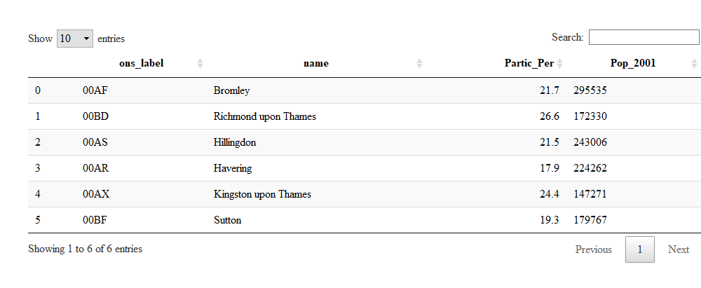
Show the Data in a Table

Slide 8
Check the Classes in the Data Slot
To check the classes of all the variables in a spatial dataset, you can use the following command:
sapply(lnd@data, class)
## ons_label name Partic_Per Pop_2001 ## "factor" "factor" "numeric" "factor"
This shows that, unexpectedly, Pop_2001 is a factor.
We can coerce the variable into the correct, numeric, format with the following command:
lnd$Pop_2001 <- as.numeric(as.character(lnd$Pop_2001))

Slide 9
Further Exploration
To explore lnd object further, try typing
nrow(lnd)
## [1] 33
ncol(lnd)
## [1] 4
lnd@proj4string
## CRS arguments: ## +proj=tmerc +lat_0=49 +lon_0=-2 +k=0.9996012717 +x_0=400000 ## +y_0=-100000 +ellps=airy +units=m +no_defs

Slide 10
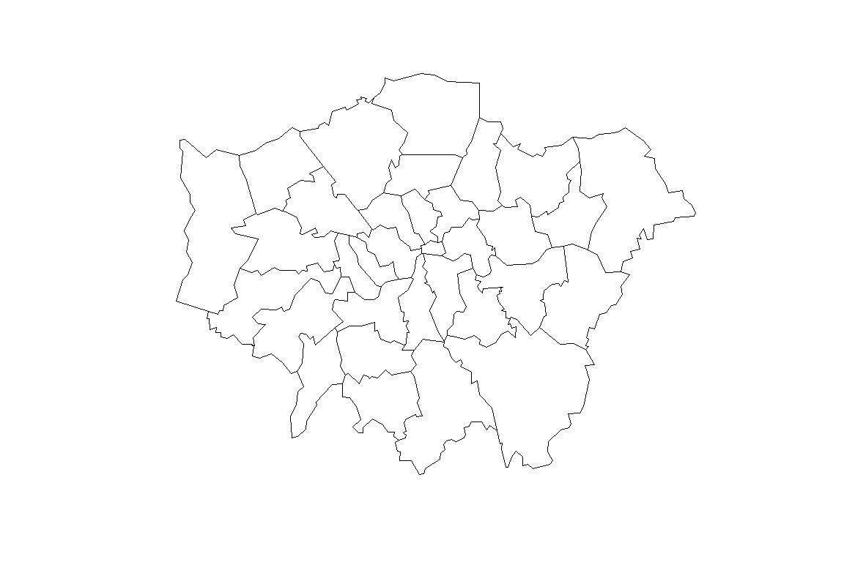
Visualize the Data
Now we have seen something of the structure of spatial objects in R, let us look at plotting them.
Note, that plots use the geometry data, contained primarily in the @polygons slot.
plot(lnd)

Slide 11
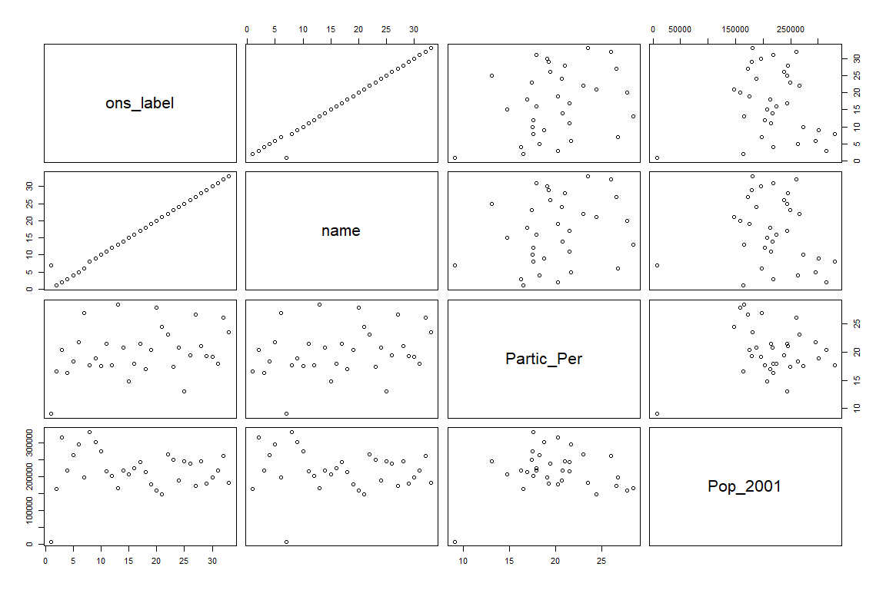
Visualize the Data
Inputting another object such as plot(lnd@data) will generate an entirely difierent type of plot
plot(lnd@data)

Slide 12
Square Brackets
R has powerful subsetting capabilities that can be accessed very concisely using square brackets
Select rows of lnd@data where sports participation is less than 15
lnd@data[lnd$Partic_Per < 15, ]
## ons_label name Partic_Per Pop_2001 ## 17 00AQ Harrow 14.8 206822 ## 21 00BB Newham 13.1 243884 ## 32 00AA City of London 9.1 7181

Slide 13
Comment on Code
The above line of code asked R to select only the rows from the lnd object, where sports participation is lower than 15, in this case rows 17, 21 and 32, which are Harrow, Newham and the city centre respectively.
The square brackets work as follows: anything before the comma refers to the rows that will be selected, anything after the comma refers to the number of columns that should be returned.
For example if the data frame had 1000 columns and you were only interested in the first two columns you could specify 1:2 after the comma.
The “:” symbol simply means “to”, i.e. columns 1 to 2.
Try experimenting with the square brackets notation (e.g. guess the result of lnd@data[1:2, 1:3] and test it).

Slide 14
The Geometry Slot
So far we have been interrogating only the attribute data slot (@data) of the lnd object
The square brackets can also be used to subset spatial objects, i.e. the geometry slot
Using the same logic as before try to plot a subset of zones with high sports participation
Select zones where sports participation is between 20 and 25%
sel <- lnd$Partic_Per > 20 & lnd$Partic_Per < 25 plot(lnd[sel, ])

Slide 15
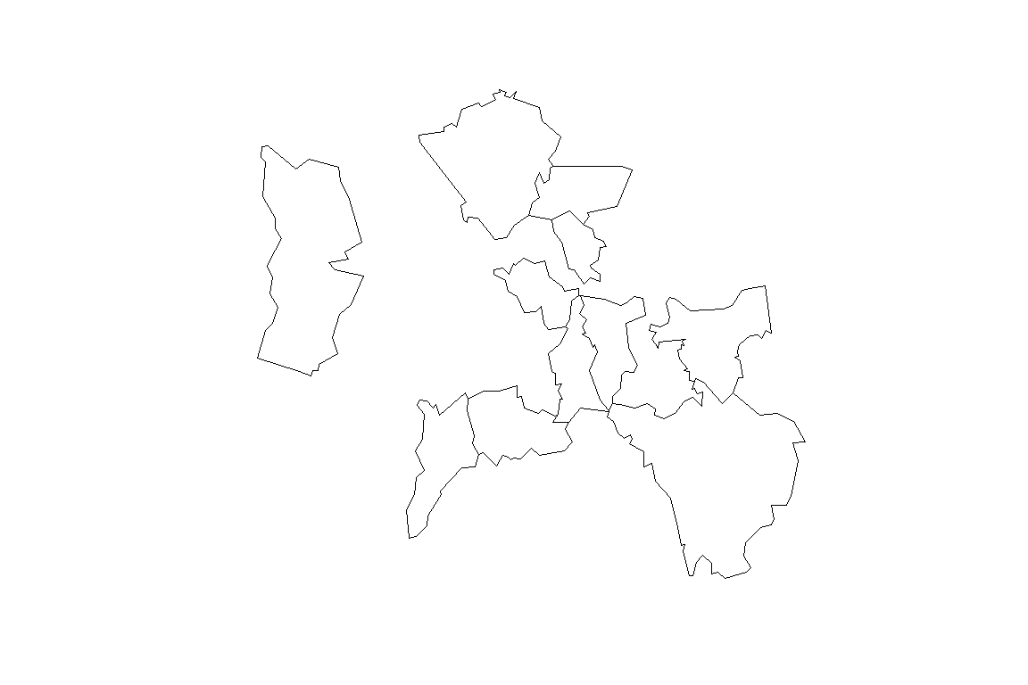
Zones with High Sports Participation

Slide 16
The Geometry Plot
This plot is quite useful, but it only displays the areas which meet the criteria.
To see the sporty areas in context with the other areas of the map simply use the add = TRUE argument after the initial plot.
(add = T would also work, but we like to spell things out in this tutorial for clarity).
What do you think the col argument refers to in the below block? (see Figure 5).
If you wish to experiment with multiple criteria queries, use &.
plot(lnd, col = "lightgrey") sel <- lnd$Partic_Per > 25 plot(lnd[sel, ], col = "turquoise", add = TRUE)

Slide 17
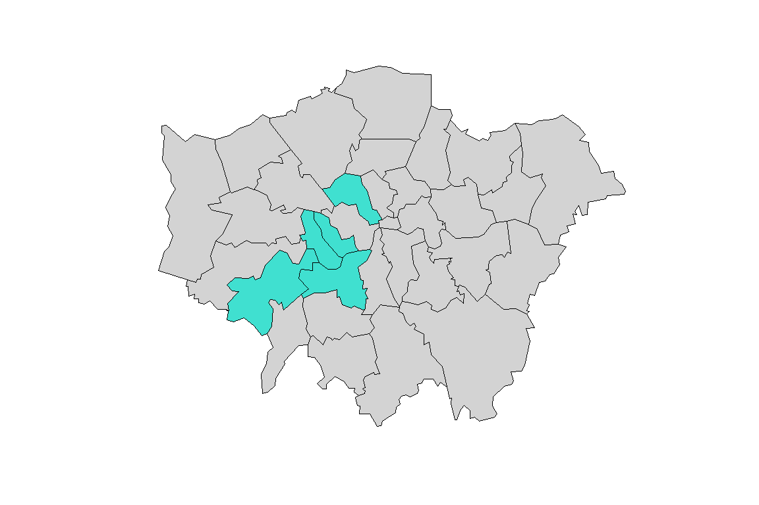
The Geometry Plot

Slide 18
Geographic Centroids - Method 1
library(rgeos) plot(lnd, col = "grey") cent_lnd <- gCentroid(lnd[lnd$name == "City of London",]) points(cent_lnd, cex = 3)
Method 1
lnd_buffer <- gBuffer(spgeom = cent_lnd, width = 10000)

Slide 19
Geographic Centroids - Method 2
Method2 of subsetting selects only points within the buffer
lnd_cents <- SpatialPoints(coordinates(lnd), proj4string = CRS(proj4string(lnd))) # create spatialpoints sel <- lnd_cents[lnd_buffer,] # select points inside buffer points(sel) # show where the points are located lnd_central <- lnd[sel,] # select zones intersecting w. sel plot(lnd_central, add = T, col = "lightslateblue", border = "grey") plot(lnd_buffer, add = T, border = "red", lwd = 2)

Slide 20
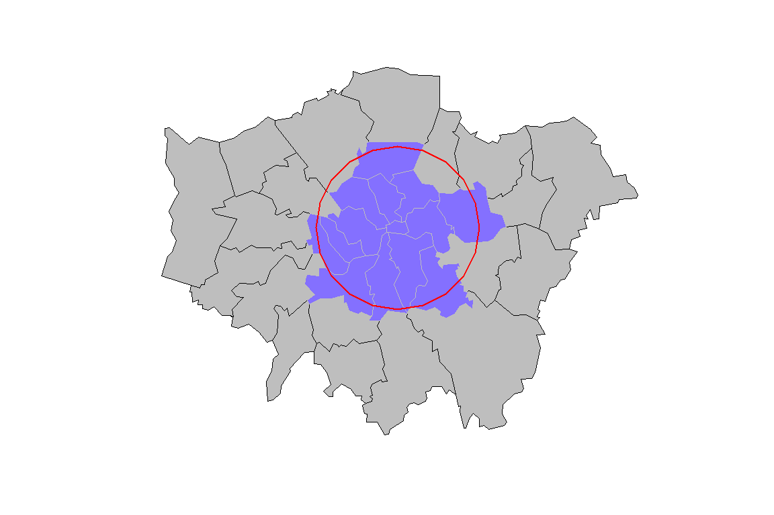
Plot of London Centroid & Buffer Zone
Plot the Centroids
Plot the Buffer Zone

Slide 21
Selecting Quadrants
The code below should help understand the way spatial data work in R.
Find the centre of the london area
lat <- coordinates(gCentroid(lnd))[[1]] lng <- coordinates(gCentroid(lnd))[[2]]
NW
north & !east
NE
north & east
SW
!north & !east
SE
!north & east

Slide 22
Test for NE Quadrant Inclusion
arguments to test whether or not a coordinate is east or north of the centre
east <- sapply(coordinates(lnd)[,1], function(x) x > lat) north <- sapply(coordinates(lnd)[,2], function(x) x > lng)
test if the coordinate is east and north of the centre
lnd@data$quadrant[east & north] <- "northeast"

Slide 23
Test for SE Quadrant Inclusion
east <- sapply(coordinates(lnd)[,1], function(x) x > lat) south <- sapply(coordinates(lnd)[,2], function(x) x < lng) lnd@data$quadrant[east & south] <- "southeast"

Slide 24
Test for NW Quadrant Inclusion
west <- sapply(coordinates(lnd)[,1], function(x) x < lat) north <- sapply(coordinates(lnd)[,2], function(x) x > lng) lnd@data$quadrant[west & north] <- "northwest"

Slide 25
Test for SW Quadrant Inclusion
west <- sapply(coordinates(lnd)[,1], function(x) x < lat) south <- sapply(coordinates(lnd)[,2], function(x) x < lng) lnd@data$quadrant[west & south] <- "southwest"

Slide 26
Plot Quadrants with Colors
plot(lnd) plot(lnd[east & north,], col = "red", add = TRUE) plot(lnd[east & south,], col = "green", add = TRUE) plot(lnd[west & north,], col = "blue", add = TRUE) plot(lnd[west & south,], col = "yellow", add = TRUE)

Slide 27
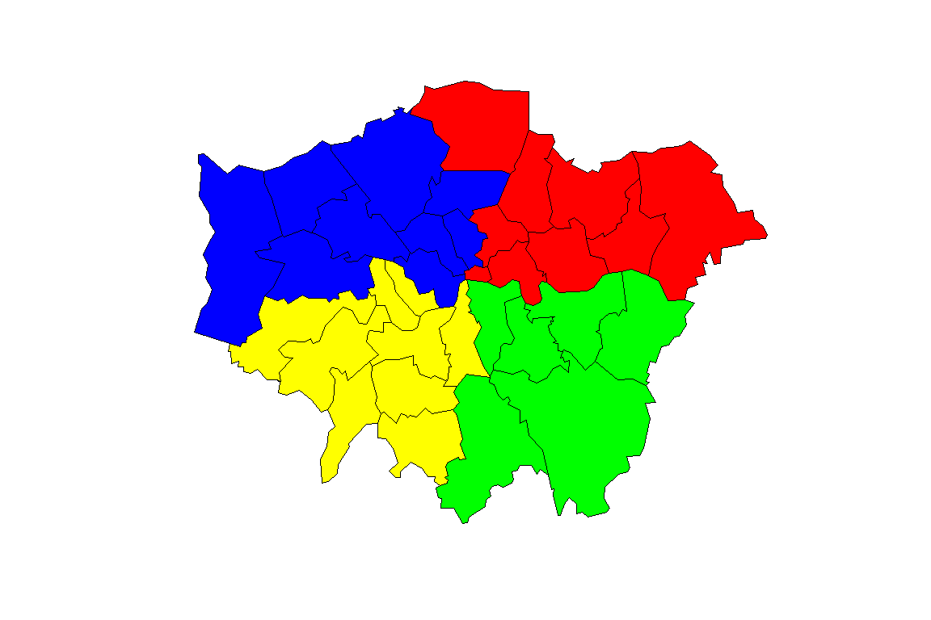
London Quadrant Plot

Slide 28
Plot with SE Quadrant Colored & add Gridlines
lnd$quadrant[!east & north] <- "northwest" lnd$quadrant[east & !north] <- "southeast" lnd$quadrant[!east & !north] <- "southwest" plot(lnd) plot(lnd[east & north,], add = TRUE, col = "red" ) llgridlines(lnd, lty= 3, side ="EN", offset = -0.5)

Slide 29
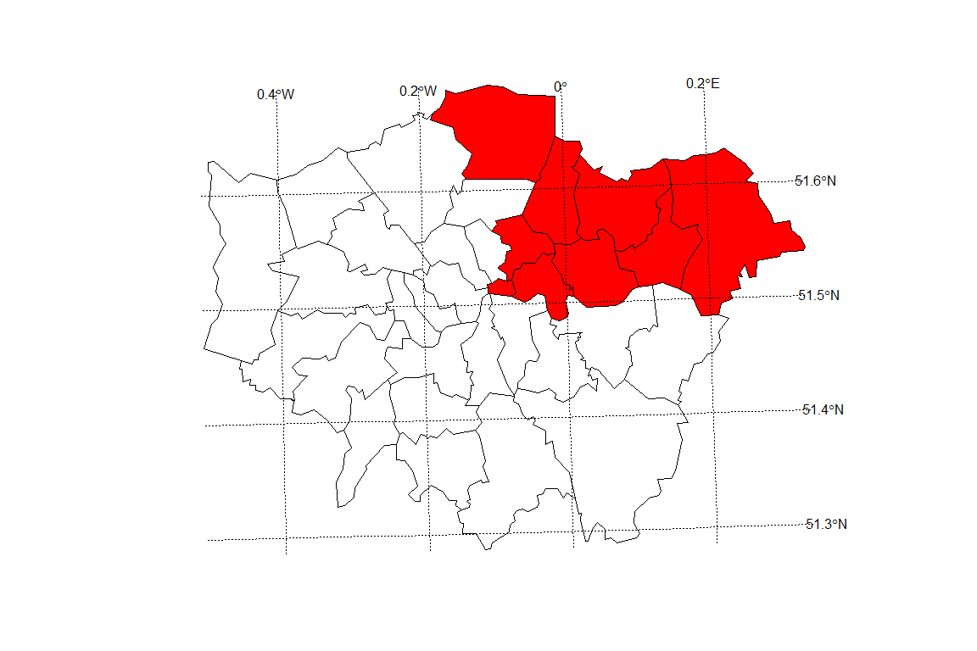
London Northeast Quadrant

Slide 30
Create and Modify Spatial Data
R’s spatial packages provide a very wide and powerful suite of functionality for processing and creating
Alongside visualisation and interrogation, a GIS must also be able to create and modify spatial data.
R’s spatial packages provide a very wide and powerful suite of functionality for processing and creating spatial data.

Slide 31
Creating New Data
R objects can be created by entering the name of the class we want to make.
vector and data.frame objects for example, can be created as follows:
vec <- vector(mode = "numeric", length = 3) df <- data.frame(x = 1:3, y = c(1/2, 2/3, 3/4))
We can check the class of these new objects using class():
class(vec)
## [1] "numeric"
class(df)
## [1] "data.frame"

Slide 32
Creating New Spatial Data
The same logic applies to spatial data. The input must be a numeric matrix or data.frame:
sp1 <- SpatialPoints(coords = df)
We have just created a spatial points object, one of the fundamental data types for spatial data
The others arelines, polygons and pixels, which can be created by SpatialLines, SpatialPolygons and SpatialPixels, respectively
Each type of spatial data has a corollary that can accepts non-spatial data, created by adding DataFrame.
SpatialPointsDataFrame(), for example, creates points with an associated data.frame.

Slide 33
Spatial Data Constraints
The number of rows in this dataset must equal the number of features in the spatial object, which in the case of sp1 is 3.
class(sp1)
## [1] "SpatialPoints" ## attr(,"package") ## [1] "sp"
spdf <- SpatialPointsDataFrame(sp1, data = df) class(spdf)
## [1] "SpatialPointsDataFrame" ## attr(,"package") ## [1] "sp"

Slide 34
Comments on Spatial Objects
The above code extends the pre-existing spatial point object (sp1) by adding data from the data frame (df).
To see how strict spatial classes are, try replacing df with mat in the above code: it causes an error.
All spatial data classes can be created in a similar way, although SpatialLines and SpatialPolygons are much more complicated (Bivand et al. 2013).
More frequently your spatial data will be read-in from an externally-created file, e.g. using readOGR().
Unlike the spatial objects we created above, most spatial data comes with an associate ‘CRS’.

Slide 35
Projections: setting and transforming CRS in R
The Coordinate Reference System (CRS) of spatial objects defines where they are placed on the surface of the Earth
You may have noticed ’proj4string ’in the summary of lnd above: the information that follows represents its CRS
Spatial data should always have a CRS.
If no CRS information is provided, and the correct CRS is known, it can be set as follow:
proj4string(lnd) <- NA_character_ # remove CRS information from lnd proj4string(lnd) <- CRS("+init=epsg:27700") # assign a new CRS

Slide 36
CSRs and EPSG codes.
Under this system 27700 represents the British National Grid.
‘WGS84’ (epsg:4326) is a very commonly used CRS worldwide.
The following code shows how to search the list of available EPSG codes and create a new version of lnd in WGS84:3
EPSG <- make_EPSG() # create data frame of available EPSG codes EPSG[grepl("WGS 84$", EPSG$note), ] # search for WGS 84 code
## code note prj4 ## 249 4326 # WGS 84 +proj=longlat +datum=WGS84 +no_defs ## 5311 4978 # WGS 84 +proj=geocent +datum=WGS84 +units=m +no_defs
lnd84 <- spTransform(lnd, CRS("+init=epsg:4326")) # reproject

Slide 37
Using spTransform
Above, spTransform converts the coordinates of lnd into the widely used WGS84CRS.
Now we’ve transformed lnd into a more widely used CRS, it is worth saving it.
R stores data efficiently in .RData or .Rds formats.
The former is more restrictive and maintains the object’s name, so we use the latter.
Save lnd84 object (we will use it in Part IV)

Slide 38
Removing Objects
Now we can remove the lnd84 object with the rm command. It will be useful later.
(In RStudio, notice it also disappears from the Environment in the top right panel.)
rm(lnd84)
we will load it back in later with readRDS(file = “data/lnd84.Rds”)

Slide 39
Attribute Joins
Attribute joins are used to link additional pieces of information to our polygons.
In the lnd object, for example, we have 4 attribute variables - that can be found by typing names(lnd).
But what happens when we want to add more variables from an external source?
We will use the example of recorded crimes by London boroughs to demonstrate this.
To reafirm our starting point, we re-load the “london_sport” shapefile as a new object and plot it
library(rgdal) # ensure rgdal is loaded lnd <- readOGR(dsn = mydir, "london_sport")
plot(lnd) # not shown

Slide 40
Joining Non-Spatial Data
The non-spatial data we are going to join to the lnd object contains records of crimes in London.
This is stored in a comma separated values (.csv) file called “mps-recordedcrime-borough”.
If you open the file in a separate spreadsheet application first, we can see each row represents a single reported crime.
We are going to use a function called aggregate to aggregate the crimes at the borough level, ready to join to our spatial lnd dataset.
A new object called crime_data is created to store this data.

Slide 41
Create and Look at New crime_data Object
crime_data <- read.csv("C:/Users/jeff/Documents/Crime Analysis/Creating-maps-in-R-master/data/mps-recordedcrime-borough.csv",
stringsAsFactors = FALSE) head(crime_data$CrimeType) # information about crime type
## [1] "Violence Against The Person" "Burglary" ## [3] "Other Notifiable Offences" "Robbery" ## [5] "Theft & Handling" "Theft & Handling"

Slide 42
Extract “Theft & Handling” Crimes
crime_theft <- crime_data[crime_data$CrimeType == "Theft & Handling", ] head(crime_theft, 2) # take a look at the result (replace 2 with 10 to see more rows)
## X.1 X Month CrimeType CrimeDetails CrimeCount ## 5 5 5 201104 Theft & Handling Handling Stolen Goods 3 ## 6 6 6 201104 Theft & Handling Theft/Taking Of Pedal Cycle 59 ## Borough ## 5 Kensington and Chelsea ## 6 Kensington and Chelsea

Slide 43
Aggregate the Crime Count by District
Calculate the Sum of the Crime Count by District
crime_ag <- aggregate(CrimeCount ~ Borough, FUN = sum, data = crime_theft)
Show the First Two Rows of Aggregated Data
head(crime_ag, 2)
## Borough CrimeCount ## 1 Barking and Dagenham 12222 ## 2 Barnet 19821

Slide 44
Exploration Comments
You should not expect to understand all of this upon first try: simply typing the commands and thinking briefly about the outputs is all that is needed at this stage.
Here are a few things that you may not have seen before that will likely be useful in the future:
In the first line of code when we read in the file we specify its location (check in your file browser to be sure).
The == function is used to select only those observations that meet a specific condition i.e. where it is equal to, in this case all crimes involving “Theft and Handling”.
The ~ symbol means “by”: we aggregated the CrimeCount variable by the district name.

Slide 45
London Boroughs
Now, that we have crime data at the borough level, the challenge is to join it to the lnd object.
We will base our join on the Borough variable from the crime_ag object and the name variable from the lnd object.
It is not always straight-forward to join objects based on names as the names do not always match.
Now, we will see which names in the crime_ag object match the spatial data object, lnd:

Slide 46
Check for Matching Row Names
Determine which “Name” Rows Match in lnd$name and crime_ag$Borough
lnd$name %in% crime_ag$Borough
## [1] TRUE TRUE TRUE TRUE TRUE TRUE TRUE TRUE TRUE TRUE TRUE ## [12] TRUE TRUE TRUE TRUE TRUE TRUE TRUE TRUE TRUE TRUE TRUE ## [23] TRUE TRUE TRUE TRUE TRUE TRUE TRUE TRUE TRUE TRUE FALSE

Slide 47
Return Rows which do not Match
lnd$name[!lnd$name %in% crime_ag$Borough]
## [1] City of London ## 33 Levels: Barking and Dagenham Barnet Bexley Brent Bromley ... Westminster
The first line of code above uses the %in% command to identify which values in lnd$name are also contained in the Borough names of the aggregated crime data.
The results indicate that all but one of the borough names matches.
The second line of code tells us that it is ‘City of London’.
This does not exist in the crime data. This may be because the City of London has its own Police Force.

Slide 48
Check for NULLs
The borough name in the crime data does not match lnd$name is ‘NULL’.
Check this by typing
crime_ag$Borough[!crime_ag$Borough %in% lnd$name]
## [1] "NULL"

Slide 49
Joining Spatial and Non-Spatial Tables
Having checked the data found that one borough does not match, we are now ready to join the spatial and non-spatial datasets.
It is recommended to use the left_join function from the dplyr package but the merge function could equally be used.
Note that when we ask for help for a function that is not loaded, nothing happens, indicating we need to load it:

Slide 50
Join the Tables
We use left_join because we want the length of the data frame to remain unchanged, with variables from new data appended in new columns (see ?left_join).
The *join commands (including inner_join and anti_join) assume, by default, that matching variables have the same name.
Here we will specify the association between variables in the two data sets:
library(dplyr) # load dplyr head(lnd$name) # dataset to add to (results not shown)
## [1] Bromley Richmond upon Thames Hillingdon ## [4] Havering Kingston upon Thames Sutton ## 33 Levels: Barking and Dagenham Barnet Bexley Brent Bromley ... Westminster
head(crime_ag$Borough) # the variables to join
## [1] "Barking and Dagenham" "Barnet" "Bexley" ## [4] "Brent" "Bromley" "Camden"
lnd@data <- left_join(lnd@data, crime_ag, by = c('name' = 'Borough'))
## Warning: Column `name`/`Borough` joining factor and character vector, ## coercing into character vector

Slide 51
Explore the New Dataset
Take a look at the new lnd@data object.
You should see new variables added, meaning the attribute join was successful
You can now plot the rate of theft crimes in London by borough

Slide 52
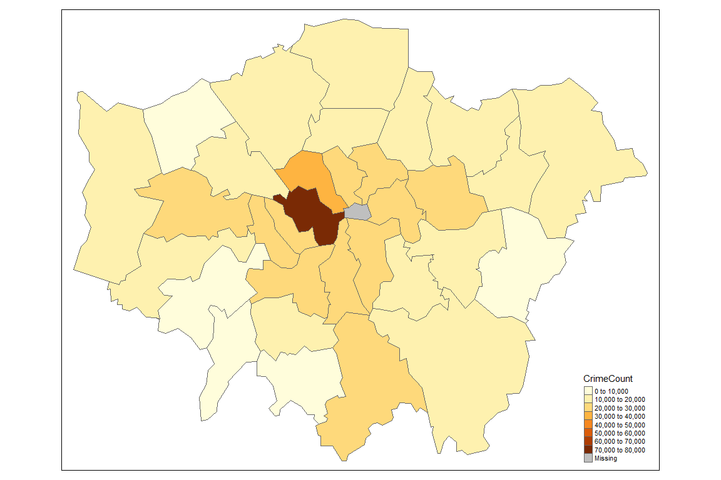
Plot a Basic Map
library(tmap) # load tmap package (see Section IV) qtm(lnd, "CrimeCount") # plot the basic map

Slide 53
Plot an Enhanced Map
library(tmap) library(tmaptools) lnd_wgs = spTransform(lnd, CRS("+init=epsg:4326")) osm_tiles = read_osm(bbox(lnd_wgs))
## Warning: Current projection unknown. Long lat coordinates (wgs84) assumed.
lnd_wgs$Thefts <- lnd$CrimeCount / 10000 tm_shape(osm_tiles) + tm_raster() + tm_shape(lnd_wgs) + tm_fill("Thefts", fill.title = "Thefts\n(10000)", scale = 0.8, alpha = 0.5) + tm_layout(legend.position = c(0.89,0.02))

Slide 54
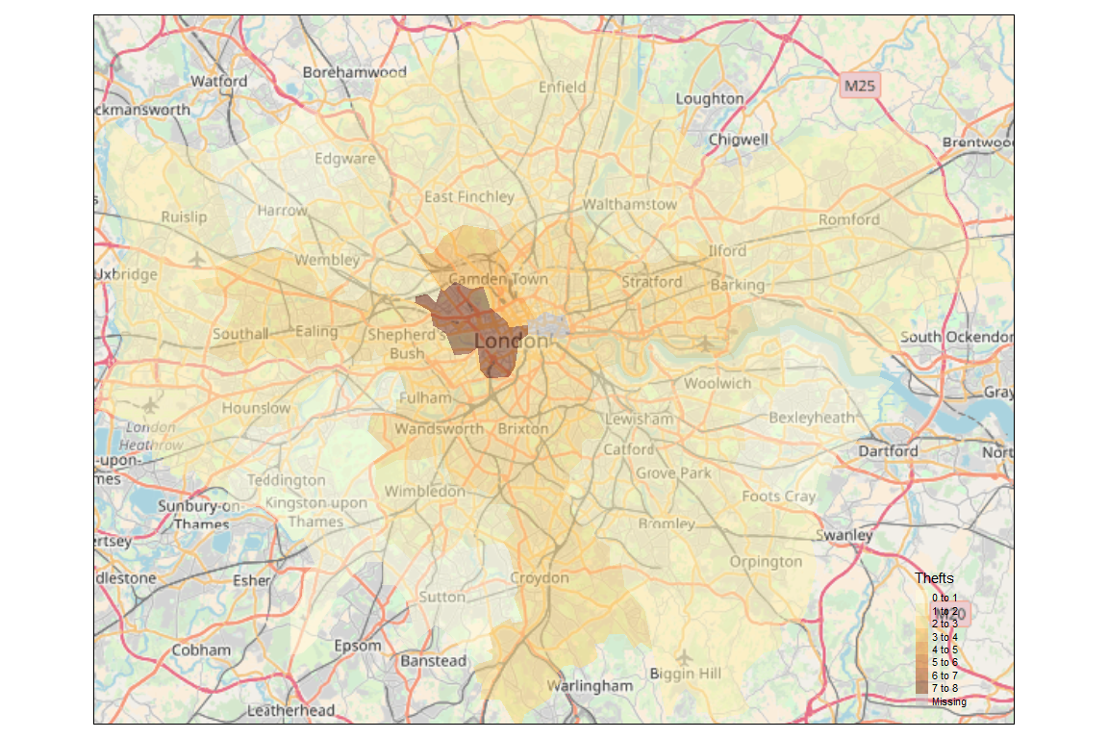
Tmap Plot of London

Slide 55
Clipping and Spatial Joins
In addition to joining by attribute (e.g. Borough name), it is also possible to do spatial joins in R.
We use transport infrastructure points as the spatial data to join, with the aim of finding out about how many are found in each London borough.

Slide 56
Create New Stations Object Using a Shapefile
library(rgdal) library(sf)
## Linking to GEOS 3.6.1, GDAL 2.2.3, proj.4 4.9.3
stations <- readOGR(dsn = mydir, layer = "lnd-stns")
proj4string(stations) # this is the full geographical detail.
## [1] "+proj=longlat +datum=WGS84 +no_defs +ellps=WGS84 +towgs84=0,0,0"
proj4string(lnd) # what's the coordinate reference system (CRS)
## [1] "+proj=tmerc +lat_0=49 +lon_0=-2 +k=0.9996012717 +x_0=400000 +y_0=-100000 +ellps=airy +units=m +no_defs"
bbox(stations) # the extent, 'bounding box' of stations
## min max ## coords.x1 -1.199066 0.9358515 ## coords.x2 50.984598 51.9398978
bbox(lnd) # return the bounding box of the lnd object
## min max ## x 503571.2 561941.1 ## y 155850.8 200932.5

Slide 57
The proj4string() Function
This function shows that the Coordinate Reference System (CRS) of stations difiers from that of our lnd object.
OSGB 1936 (or EPSG 27700) is the oficial CRS for the UK, so we will convert the ‘stations’ object to this:

Slide 58
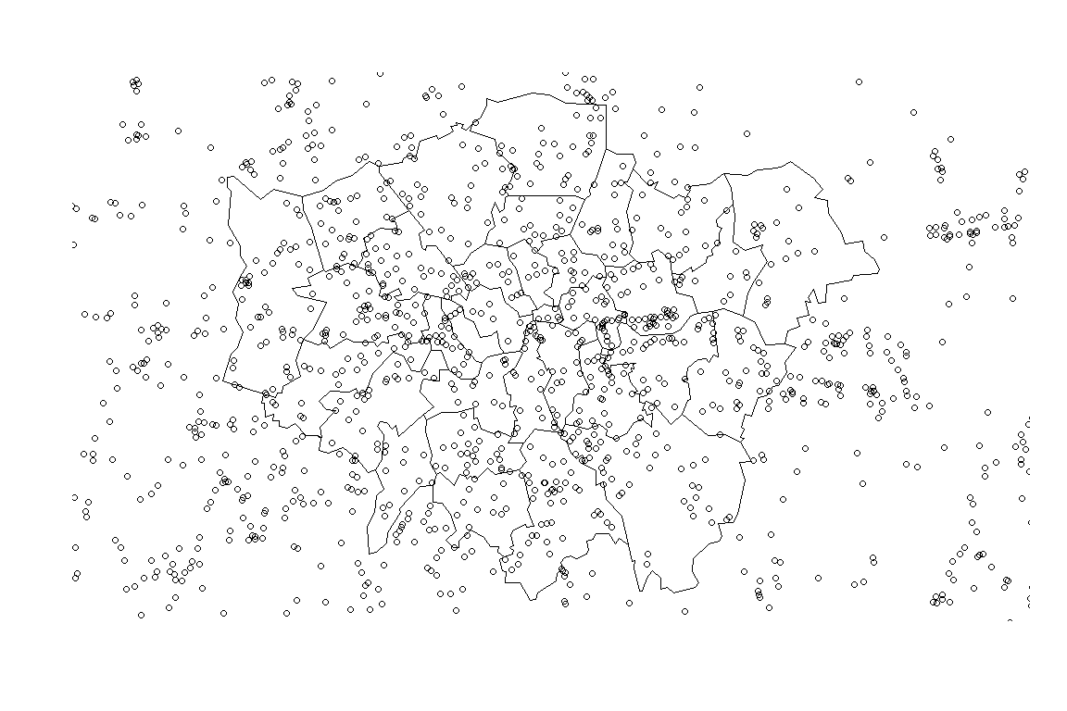
Create Reprojected Stations Object
stations <- spTransform(stations, CRSobj = CRS(proj4string(lnd))) plot(lnd) # plot London points(stations) # overlay the station points

Slide 59
Commenst on Stations Objects
Note the stations points now overlay the boroughs but that the spatial extent of stations is greater than that of lnd.
To clip the stations so that only those falling within London boroughs are retained we can use sp::over, or simply the square bracket notation for subsetting tabular data
Enter ?gIntersects to find out another way to do this
stations <- stations[lnd, ] plot(stations) # test the clip succeeded

Slide 60
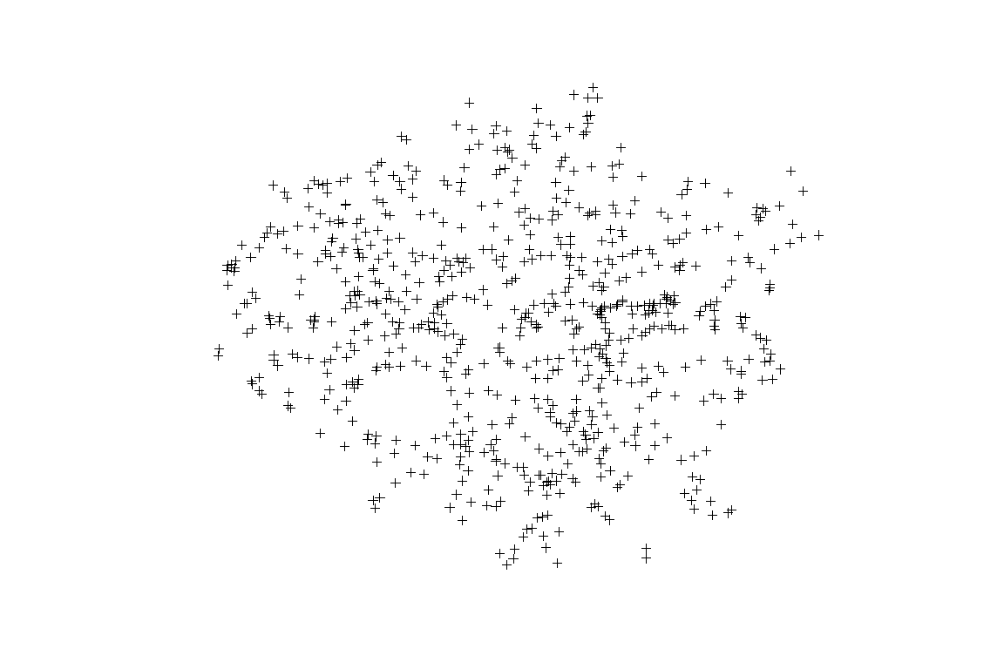
Station Symbols
stations <- stations[lnd, ]
plot(stations)
# test the clip succeeded

Slide 61
Comments on the Code
The above line of code says: “output all stations within the lnd object bounds”, a concise way of clipping that is consistent with Rs syntax for non-spatial clipping.
To prove it worked, only stations within the London boroughs appear in the plot.
gIntersects can achieve the same result, but with more lines of code (see www.rpubs.com/RobinLovelace for more on this).
It may seem confusing that two different functions can be used to generate the same result.
However, this is a common issue in R; the question is finding the most appropriate solution.

Slide 62
Viewing the Summary
Typing summary(sel) should provide insight into how this worked: it is a data frame with 1801 NA values, representing zones outside of the London polygon.
Note that the preceding two lines of code is equivalent to the single line of code, stations <- stations[lnd, ].
The next section demonstrates spatial aggregation, a more advanced version of spatial subsetting.
summary(sel)
## Object of class SpatialPoints ## Coordinates: ## min max ## coords.x1 523592.6 541466.2 ## coords.x2 174026.6 189667.2 ## Is projected: TRUE ## proj4string : ## [+proj=tmerc +lat_0=49 +lon_0=-2 +k=0.9996012717 +x_0=400000 ## +y_0=-100000 +ellps=airy +units=m +no_defs] ## Number of points: 14

Slide 63
Spatial aggregation
As with Rs very terse code for spatial subsetting, the base function aggregate (which provides summaries of variables based on some grouping variable) also behaves differently when the inputs are spatial objects.
stations_agg <- aggregate(x = stations["CODE"], by = lnd, FUN = length) head(stations_agg@data)
## CODE ## 0 48 ## 1 22 ## 2 43 ## 3 18 ## 4 12 ## 5 13

Slide 64
Comments about the Code
The above code performs a number of steps in just one line:
aggregate identifies which lnd polygon (borough) each station is located in and groups them accordingly. The use of the syntax stations["CODE"] tells R that we are interested in the spatial data from stations and its CODE variable (any variable could have been used here as we are merely counting how many points exist).
It counts the number of stations points in each borough, using the function length.
A new spatial object is created, with the same geometry as lnd, and assigned the name stations_agg, the count of stations.

Slide 65
Extract the Raw Count Data
To extract the raw count data, one could enter stations_agg$CODE.
This variable could be added to the original lnd object as a new field, as follows:
lnd$n_points <- stations_agg$CODE

Slide 66
Spatial Implementation of aggregate
As shown below, the spatial implementation of aggregate can provide summary statistics of variables, as well as simple counts.
In this case we take the variable NUMBER and find its mean value for the stations in each ward.
See the miniature Vignette ‘Clipping and aggregating spatial data with gIntersects’ for more information on this: http://rpubs.com/RobinLovelace/83834
lnd_n <- aggregate(stations["NUMBER"], by = lnd, FUN = mean)

Slide 67
Analyze and Plot the Result
For an optional advanced task, let us analyze and plot the result.
library(ggplot2) q <- cut_number(lnd_n$NUMBER,4) # a nice little function from ggplot2 q <- factor(q, labels = c("red", "green", "yellow", "blue")) summary(q)
## #4D4D4D #969696 #C3C3C3 #E6E6E6 ## 9 8 8 8
qc <- as.character(q) # convert to character class to plot plot(lnd_n, col = qc) # plot (not shown in printed tutorial) legend(legend = paste0("Q", 1:4), fill = levels(q), "topright")

Slide 68
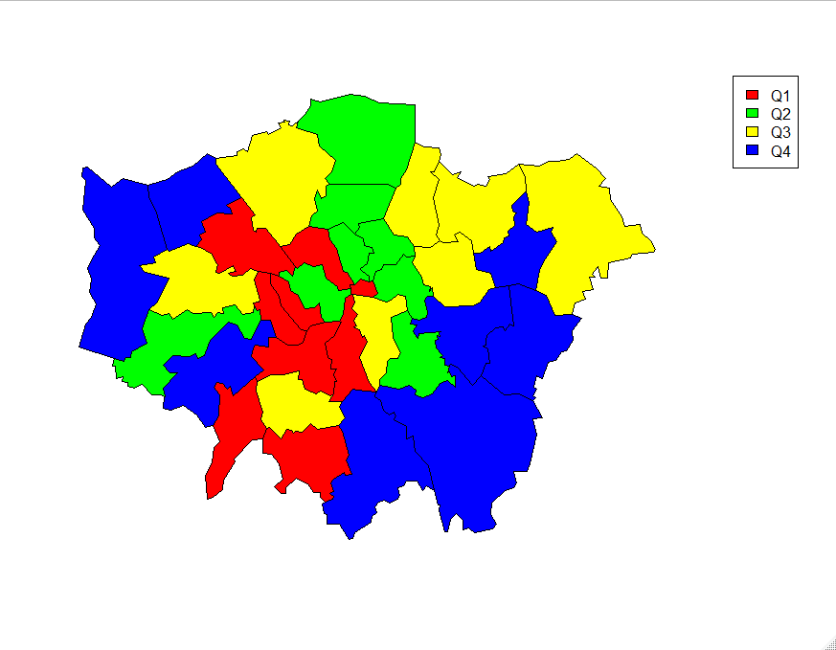
Levels Plot
areas <- sapply(lnd_n@polygons,
function(x) x@area)

Slide 69
Comments on the Plot
This results in a simple choropleth map and a new vector containing the area of each borough
As an additional step, try comparing the mean area of each borough with the mean value of stations points within it:
plot(lnd_n$NUMBER, areas)

Slide 70
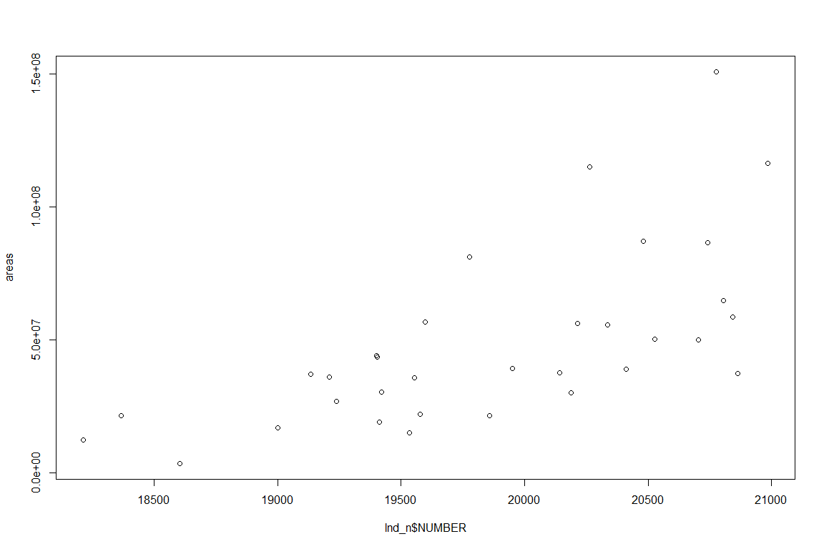
Adding Tube and Train Stations

Slide 71
Adding symbols for tube and train stations
Imagine now that we want to display all tube and train stations on top of the previously created choropleth map.
How would we do this?
The shape of points in R is determined by the pch argument, as demonstrated by the result of entering the following code: plot(1:10, pch=1:10)
To apply this knowledge to our map, try adding the following code to the chunk above (output not shown):

Slide 72
Format the Legend
levels(stations$LEGEND) # see A roads and rapid transit stations (RTS) (not shown) sel <- grepl("A Road Sing|Rapid", stations$LEGEND) # selection for plotting sym <- as.integer(stations$LEGEND[sel]) # symbols points(stations[sel,], pch = sym) legend(legend = c("A Road", "RTS"), "bottomright", pch = unique(sym))

Slide 73
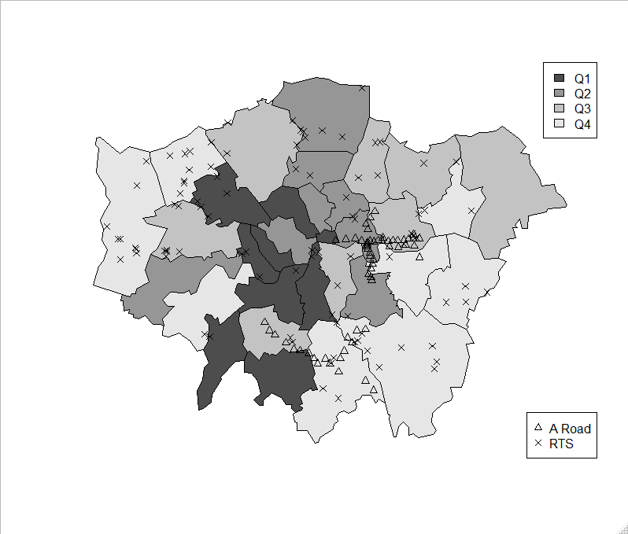
Tube and Train Stations with Legend

Slide 74
Tube and Train Station Output
## #4D4D4D #969696 #C3C3C3 #E6E6E6 ## 9 8 8 8 ## [1] "Railway Station" ## [2] "Rapid Transit Station" ## [3] "Roundabout, A Road Dual Carriageway" ## [4] "Roundabout, A Road Single Carriageway" ## [5] "Roundabout, B Road Dual Carriageway" ## [6] "Roundabout, B Road Single Carriageway" ## [7] "Roundabout, Minor Road over 4 metres wide" ## [8] "Roundabout, Primary Route Dual Carriageway" ## [9] "Roundabout, Primary Route Single C'way"

Slide 75
Comments on the Code
The above block of code first identifies which types of transport points are present in the map with levels (this command only works on factor data).
Next we select a subset of stations using a new command, grepl, to determine which points we want to plot.
Note that grepl's first argument is a text string (hence the quote marks) and the second is a factor (try typing class(stations$LEGEND) to test this).
grepl` uses regular expressions to match whether each element in a vector of text or factor names match the text pattern we want.
In this case, because we are only interested in roundabouts that are A roads and Rapid Transit systems (RTS).
Note the use of the vertical separator | to indicate that we want to match LEGEND names that contain either “A Road” or “Rapid”.
Based on the positive matches (saved as sel, a vector of TRUE and FALSE values), we subset the stations.
Finally we plot these as points, using the integer of their name to decide the symbol and add a legend.

Slide 76
Making maps with tmap
tmap was created to overcome some of the limitations of base graphics and ggmap.
A concise introduction to tmap can be accessed (after the package is installed) by using the vignette function:
library(tmap) vignette("tmap-getstarted")
## starting httpd help server ... done
A couple of basic plots show the package intuitive syntax and attractive default parameters.
qtm(shp = lnd, fill = "Partic_Per", fill.palette = "-Blues") # not shown

Slide 77
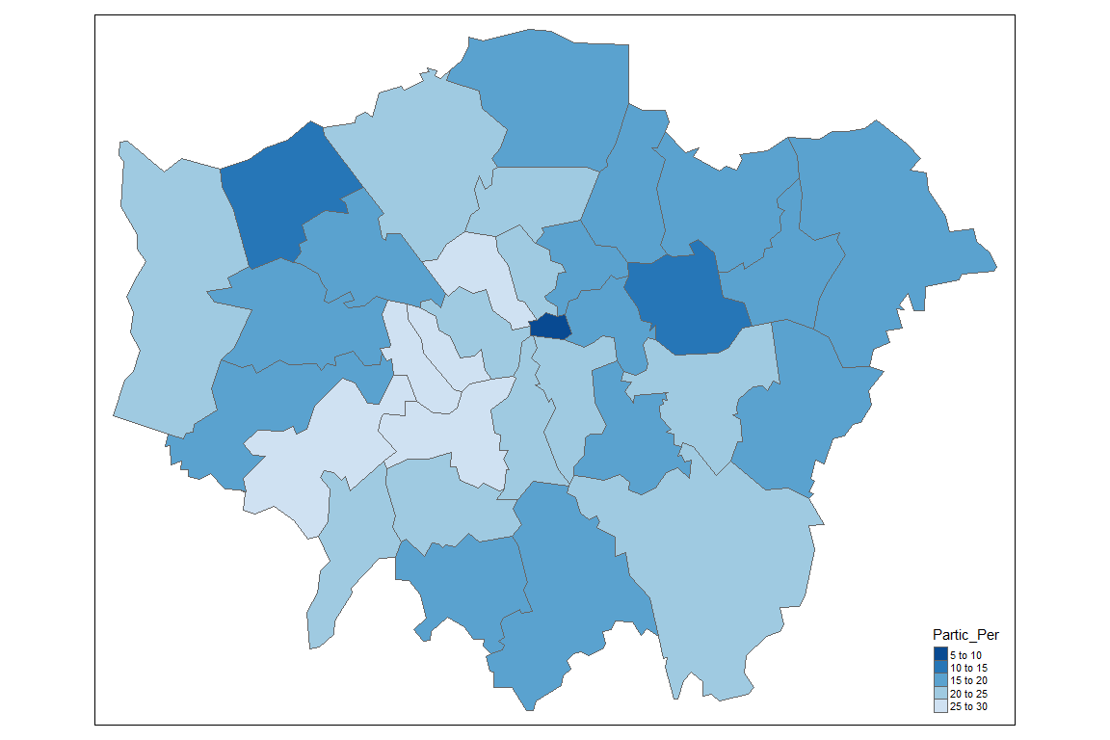
Plot Partic_Per

Slide 78
Plot Partic_Per and Pop_2001
qtm(shp = lnd, fill = c("Partic_Per", "Pop_2001"),
fill.palette = "Blues", nrow = 1)
## Warning: Number of levels of the variable "Pop_2001" is 33, which is ## larger than max.categories (which is 30), so levels are combined. Set ## tmap_options(max.categories = 33) in the layer function to show all levels.

Slide 79
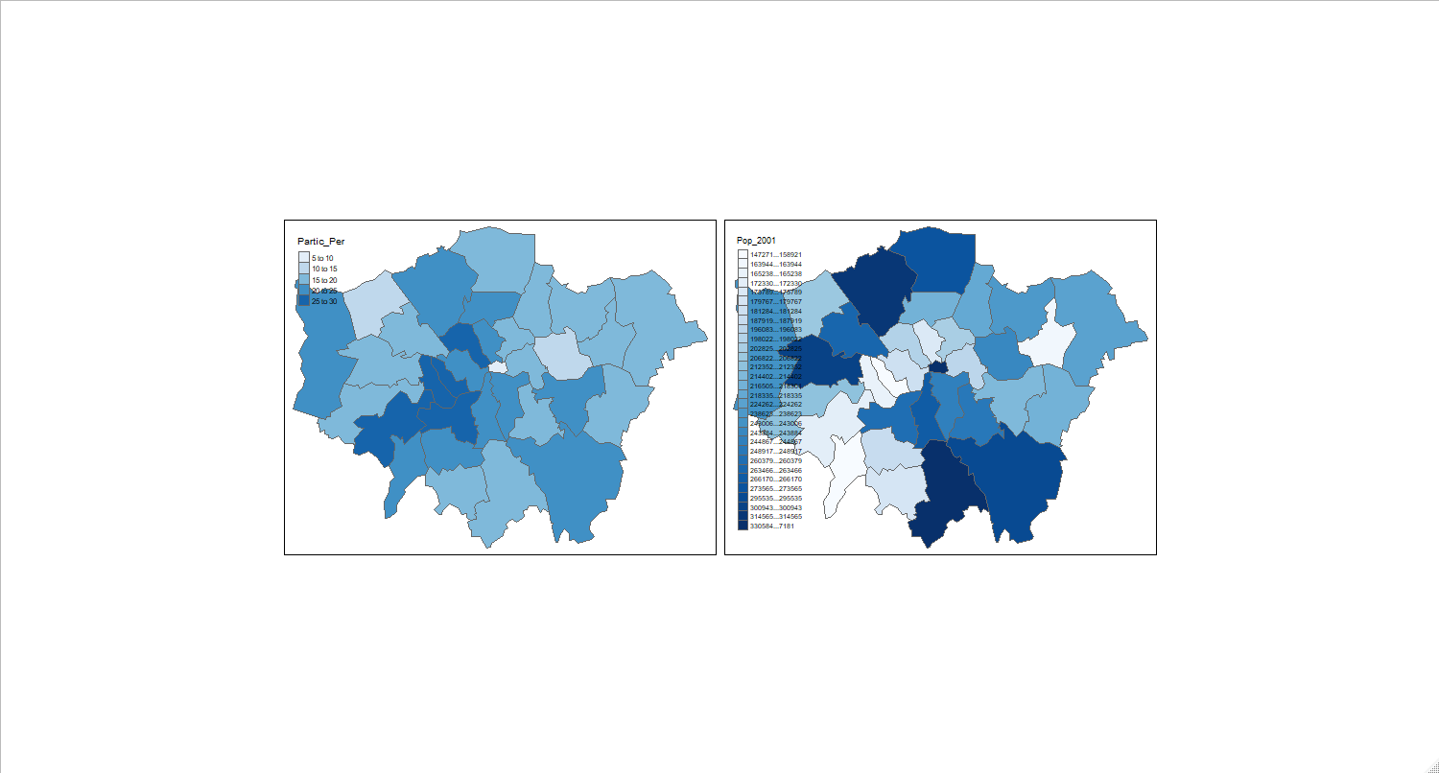
Plot Partic_Per and Pop_2001

Slide 80
Comments on the Plot
The plot above shows the ease with which tmap can create maps next to each other for different variables.
The plot produced by the following code chunk (not shown) demonstrates the power of the tm_facets command.
Note that all the maps created with the qtm function can also be created with tm_shape, followed by tm_fill (or another tm_ function).

Slide 81
Enhance the Plot
tm_shape(lnd) + tm_fill("Pop_2001", thres.poly = 0) + tm_facets("name", free.coords = TRUE, drop.units = TRUE)
## Warning: Number of levels of the variable "Pop_2001" is 33, which is ## larger than max.categories (which is 30), so levels are combined. Set ## tmap_options(max.categories = 33) in the layer function to show all levels.

Slide 82
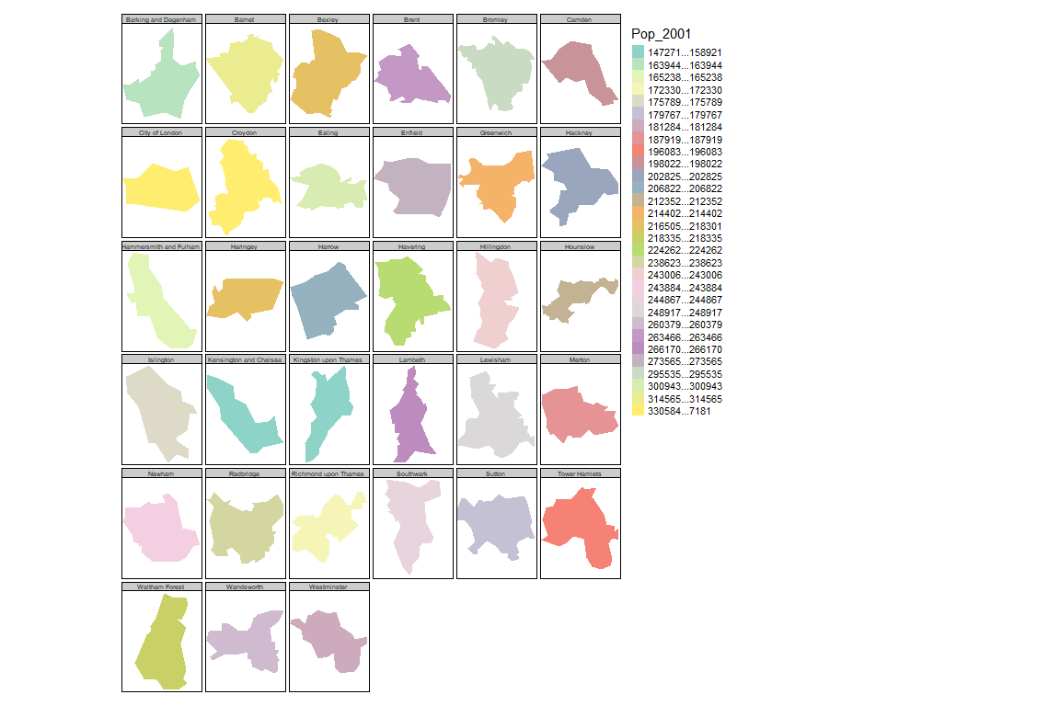
Plot Burroughs with Populations

Slide 83
Create a Basemap
To create a basemap with tmap, you can use the read_osm function, from the tmaptools package as follows.
Note that you must first transform the data into a geographical CRS:

Slide 84
Transform the coordinate reference system
library(OpenStreetMap) lnd_wgs = spTransform(lnd, CRS("+init=epsg:4326")) osm_tiles = tmaptools::read_osm(bbox(lnd_wgs)) # download images from OSM
## Warning: Current projection unknown. Long lat coordinates (wgs84) assumed.

Slide 85
Generate the Plot
tm_shape(osm_tiles) + tm_raster() + tm_shape(lnd_wgs) + tm_fill("Pop_2001", fill.title = "Population, 2001", scale = 0.8, alpha = 0.5) + tm_layout(legend.position = c(0.89,0.02))
## Warning: Number of levels of the variable "Pop_2001" is 33, which is ## larger than max.categories (which is 30), so levels are combined. Set ## tmap_options(max.categories = 33) in the layer function to show all levels.

Slide 86
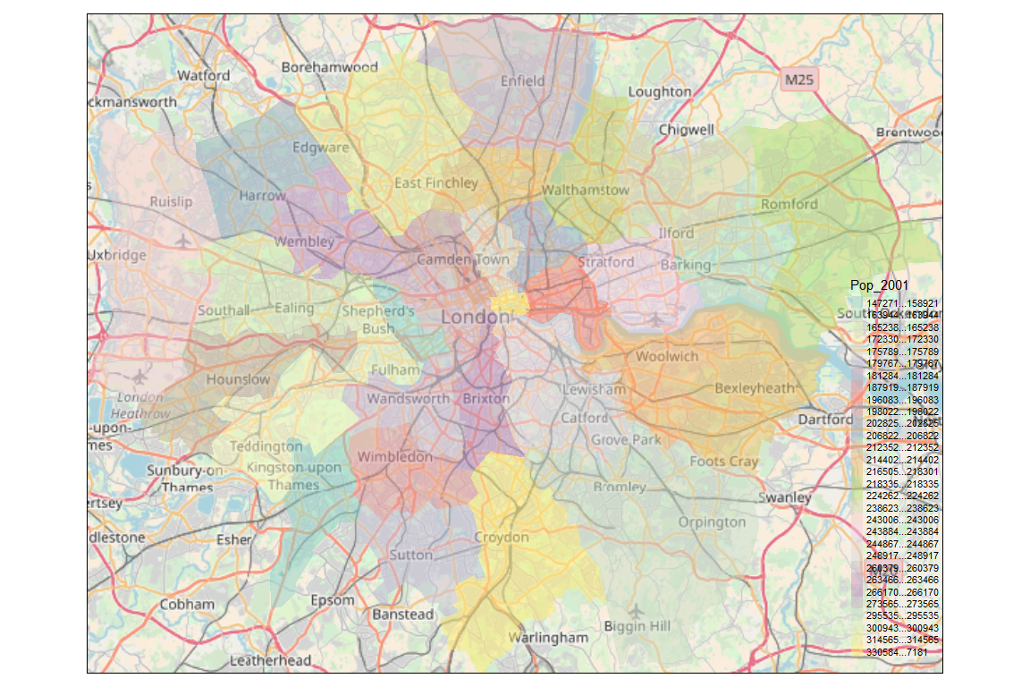
Basemap Plot

Slide 87
Alternatives
Another way to make tmap maps have a basemap is by entering tmap_mode(“view”).
This will make the maps appear on a zoomable webmap powered by leaflet.
There are many other intuitive and powerful functions in tmap.
Check the documentation to find out more:
?tmap # get more info on tmap

Slide 88
Making Maps with ggmap
ggmap is based on the ggplot2 package, an implementation of the Grammar of Graphics (Wilkinson 2005).
ggplot2 can replace the base graphics in R (the functions you have been plotting with so far).
It contains default options that match good visualisation practice and is well-documented: http://docs.ggplot2.org/ current/ .

Slide 89
Create a Scatter Plot
library(ggplot2) p <- ggplot(lnd@data, aes(Partic_Per, Pop_2001))
The real power of ggplot2 lies in its ability to add layers to a plot
We specify with geom_point that this is a scatter plot
geom_line would have created a line plot
geom_bar would have created a bar chart
We can add text to the plot (second line)
p + geom_point(aes(colour = Partic_Per, size = Pop_2001)) +
geom_text(size = 2, aes(label = name))

Slide 90
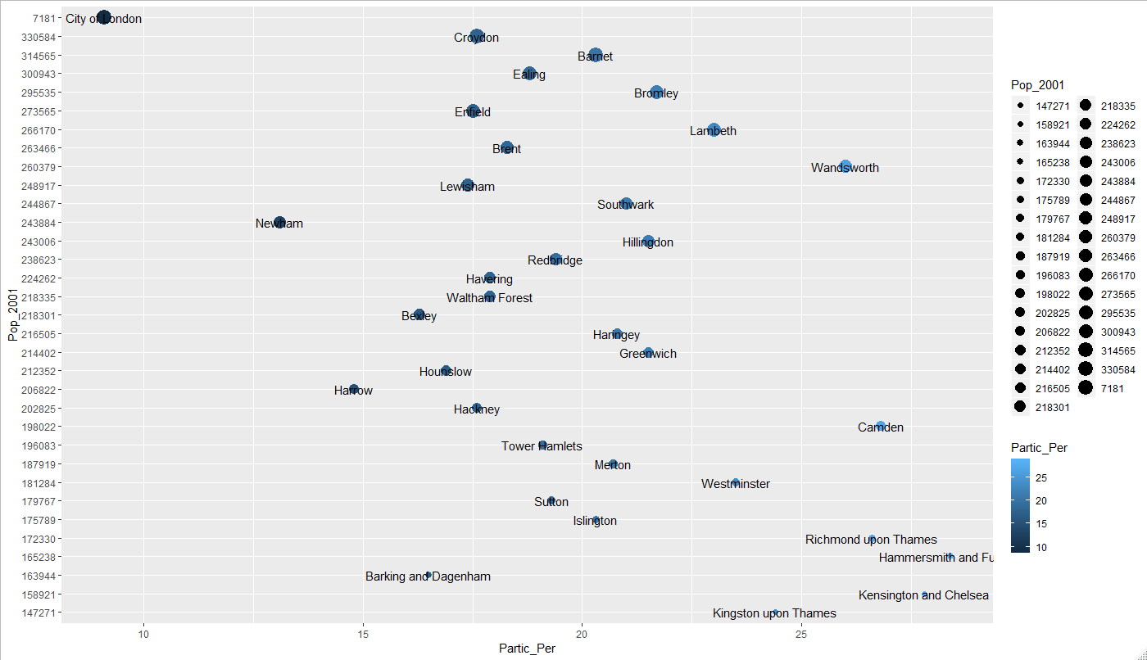
Scatterplot with Population and Labels

Slide 91
Comments about Layers
This idea of layers (or geoms) is quite different from the standard plot functions in R
You will find that each of the functions does a lot of clever stuff to make plotting much easier (see the documentation for a full list).

Slide 92
Creating Dataframes
In the following steps we will create a map to show the percentage of the population in each London Borough who regularly participate in sports activities.
ggmap requires spatial data to be supplied as data.frame, using fortify().
The generic plot() function can use Spatial* objects directly; ggplot2 cannot.
Therefore we need to extract them as a data frame.
The fortify function was written specifically for this purpose.
For this to work, either the maptools or rgeos packages must be installed.

Slide 93
The Fortify Function
This function turns a map (map data) into a data frame that can more easily be plotted with ggplot2
library(ggplot2) lnd_f <- fortify(lnd) ## Regions defined for each Polygons
## Regions defined for each Polygons

Slide 94
Attribute Information
This step has lost the attribute information associated with the lnd object.
We can add it back using the left_join function from the dplyr package (see ?left_join).
head(lnd_f, n = 2) # peak at the fortified data
## long lat order hole piece id group ## 1 541177.7 173555.7 1 FALSE 1 0 0.1 ## 2 541872.2 173305.8 2 FALSE 1 0 0.1
lnd$id <- row.names(lnd) # allocate an id variable to the sp data head(lnd@data, n = 2) # final check before join (requires shared variable name)
## ons_label name Partic_Per Pop_2001 CrimeCount n_points ## 1 00AF Bromley 21.7 295535 15172 48 ## 2 00BD Richmond upon Thames 26.6 172330 9715 22 lnd_f <- left_join(lnd_f, lnd@data) # join the data
## Joining, by = "id"

Slide 95
Plotting the New Object
The new lnd_f object contains coordinates alongside the attribute information associated with each London Borough.
It is now straightforward to produce a map with ggplot2.
coord_equal() is the equivalent of asp = T in regular plots with R:
map <- ggplot(lnd_f, aes(long, lat, group = group, fill = Partic_Per)) + geom_polygon() + coord_equal() + labs(x = "Easting (m)", y = "Northing (m)", fill = "% Sports\nParticipation") + ggtitle("London Sports Participation") map + scale_fill_gradient(low = "white", high = "blue")

Slide 96
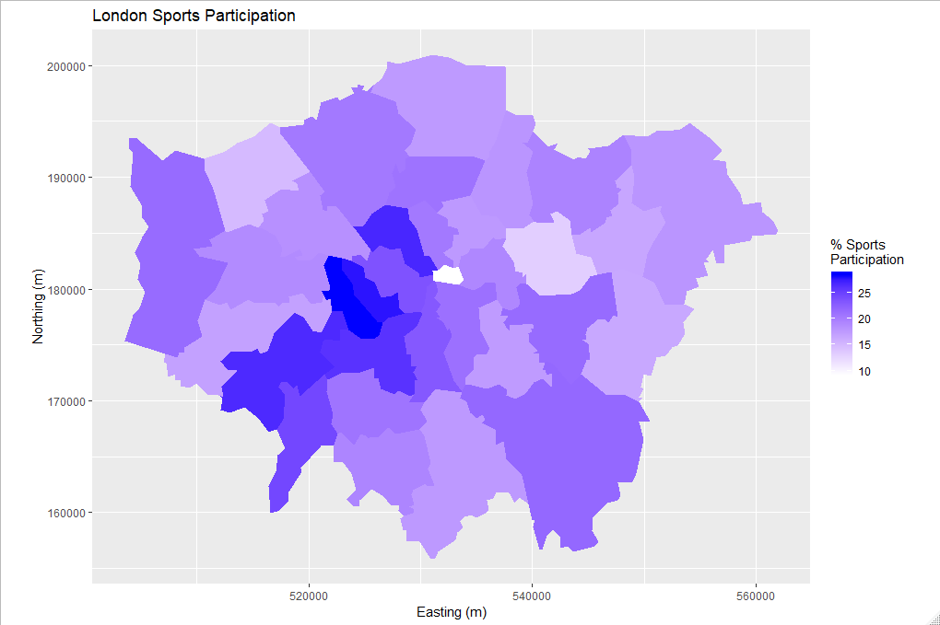
Plot of London Sports Participation

Slide 97
Creating interactive maps with Leaflet
Leaflet is the worlds premier web mapping system, serving hundreds of thousands of maps worldwide each day.
The JavaScript library actively developed at github.com/Leafiet/Leafiet, has a strong user community.
It is fast, powerful and easy to learn.
The leaflet package creates interactive web maps in few lines of code.
One of the exciting things about the package is its tight integration with the R package for interactive on-line visualisation, shiny.
Used together, these allow R to act as a complete map-serving platform, to compete with the likes of GeoServer!
For more information on rstudio/leafiet, see rstudio.github.io/leafiet/ and the following on-line tutorial: robinlovelace.net/r/2015/02/01/leafiet-r-package.html.

Slide 98
Generate Map from lnd84.rds
library(leaflet) lnd84 <- readRDS('C:/Users/jeff/Documents/Crime Analysis/Creating-maps-in-R-master/data/lnd84.Rds') leaflet() %>% addTiles() %>% addPolygons(data = lnd84)

Slide 99
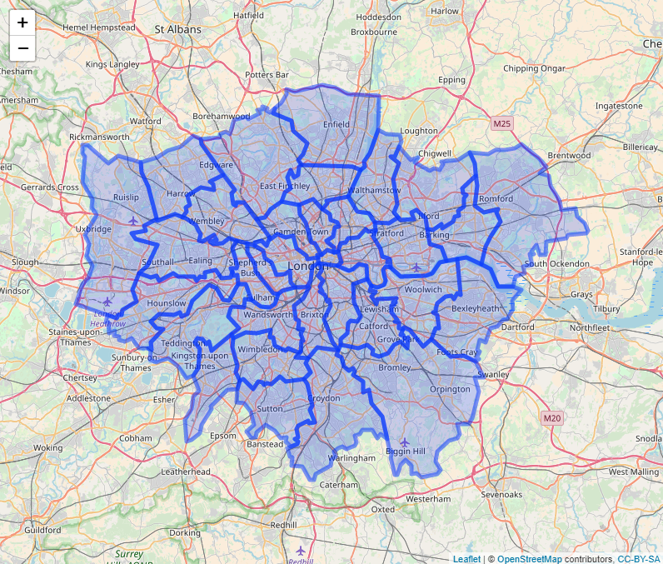
Map from lnd84.rds

Slide 100
Advanced Task: Faceting for Maps
The below code demonstrates how to read in the necessary data for this task and ‘tidy’ it up.
The data file contains historic population values between 1801 and 2001 for London, again from the London data store.
We tidy the data so that the columns become rows.
In other words, we convert the data from ‘fiat’ to ‘long’ format.
This is the form required by ggplot2 for faceting graphics:
the date of the population survey becomes a variable in its own right, rather than being strung-out over many columns.

Slide 101
Tidy up the data
london_data <- read.csv("C:/Users/jeff/Documents/Crime Analysis/Creating-maps-in-R-master/data/census-historic-population-borough.csv") library(tidyr) # if not install it, or skip the next two steps library(dplyr) ltidy <- gather(london_data, date, pop, -Area.Code, -Area.Name) head(ltidy, 2) # check the output
## Area.Code Area.Name date pop ## 1 00AA City of London Pop_1801 129000 ## 2 00AB Barking and Dagenham Pop_1801 3000

Slide 102
Comments on Tidy
In the above code we take the london_data object and create the column names ‘date’ (the date of the record, previously spread over many columns) and ‘pop’ (the population which varies).
The minus (-) symbol in this context tells gather not to include the Area.Name and Area.Code as columns to be removed.
In other words, “leave these columns be”.
Data tidying is an important subject: more can be read on the subject in Wickham (2014) or in a vignette about the package, accessed from within R by entering vignette(“tidy-data”).

Slide 103
Merge the Population Data
Merge with the London borough geometry contained within our lnd_f object, using the left_join function from the dplyr package:
head(lnd_f, 2) # identify shared variables with ltidy
## long lat order hole piece id group ons_label name ## 1 541177.7 173555.7 1 FALSE 1 0 0.1 00AF Bromley ## 2 541872.2 173305.8 2 FALSE 1 0 0.1 00AF Bromley ## Partic_Per Pop_2001 CrimeCount n_points ## 1 21.7 295535 15172 48 ## 2 21.7 295535 15172 48
ltidy <- rename(ltidy, ons_label = Area.Code) # rename Area.code variable lnd_f <- left_join(lnd_f, ltidy)
## Joining, by = "ons_label"
## Warning: Column `ons_label` joining factors with different levels, coercing ## to character vector

Slide 104
Rename the date variable
Use ?gsub and Google ‘regex’ to find out more.
lnd_f$date <- gsub(pattern = "Pop_", replacement = "", lnd_f$date)
Sub and gsub return a character vector of the same length and with the same attributes as x (after possible coercion to character)
Elements of character vectors x which are not substituted will be returned unchanged (including any declared encoding)
If useBytes = FALSE a non-ASCII substituted result will often be in UTF-8 with a marked encoding

Slide 105
Use Faceting to Produce One Map per year
library(ggplot2) ggplot(data = lnd_f, # the input data aes(x = long, y = lat, fill = pop/1000, group = group)) + # define variables geom_polygon() + # plot the boroughs geom_path(colour="black", lwd=0.05) + # borough borders coord_equal() + # fixed x and y scales facet_wrap(~ date) + # one plot per time slice scale_fill_gradient2(low = "blue", mid = "grey", high = "red", # colors midpoint = 150, name = "Population\n(thousands)") + # legend options theme(axis.text = element_blank(), # change the theme options axis.title = element_blank(), # remove axis titles axis.ticks = element_blank()) # remove axis ticks

Slide 106
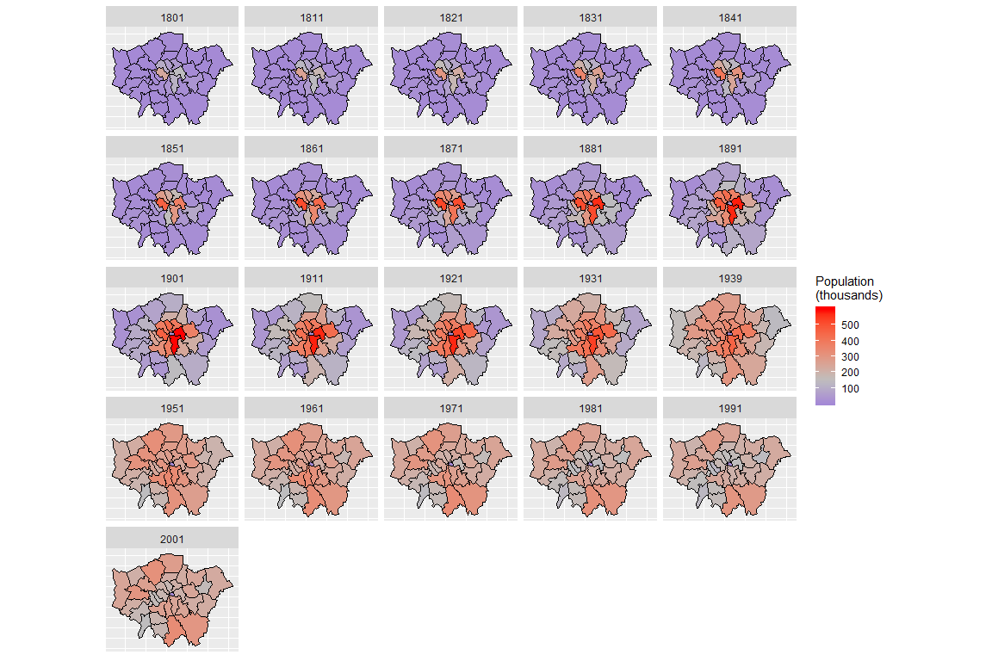
London Sports Participation Map for Each Year

